Slide 1

Purdue University | 2025
Natural Language Processing with Disaster Tweets
Team:
Abhishek Baskar
Vimala Shravani

Slide 2
Purdue University | 2025
Introduction
Our aim was to utilize the Deep Learning algorithms like LSTMs, GRUs and BERT to accurately predict tweets about real disasters and those that are not

Slide 3
Purdue University | 2025
Dataset Overview
Source
The dataset comes from a real-world Twitter data, containing tweets labeled disaster or not.
Size
10000+ tweets (split between test and training), with binary labels indicating whether a tweet describes disaster or not
Text : Main content of tweet
Target : Binary label indicating the disaster ( 1 or 0)
Keywords : Important words extracted from a tweet
Location : Geographical Information
Features

Slide 4
Purdue University | 2025
Data Pre-Processing Techniques
01
Combining the data from location and keyword columns with the text column
04
Tokenizing – our dictionary size was 2000, upon increasing our models overfit the data
02
Data Augmentation – generating new tweets using existing tweets
05
Embedding – The latent space was a 32 dimension vector, this was the number that gave us the best result
03
Lemmatization - this caused a reduction in accuracy, so we dropped it

Slide 5
Purdue University | 2025
Embedding and Data Augmentation
Embedding
Data Augmentation
Word2Vec helps in cases where it is important for the model to learn about words that are similar given a context, could be more applicable if the task was machine translation or word generation
The Keras inbuilt embedding will learn according to the task at hand, binary classification in this case, which could be why it worked better
We generated additional data in the following ways:
Concatenation of two whole tweets
Combining chunks of two tweets
Replacing the words of a tweet with its synonyms
These techniques helped increase the training data to 25.5k records from 6.5k records (after 90-10 training and validation split)

Slide 6
Purdue University | 2025
Models that we tried..
Basic Models
Advanced
Models
All the models had the 3 layers, 128 neurons each with 10% dropout in layer 1, 20% in layer 2 and 30% in layer 3, and they used Adam as the optimizer with a learning rate of 0.0001.
Models we tried:
Stacked LSTM
Stacked Bidirectional LSTM
Stacked GRU
Stacked Bidirectional LSTM
DistilBERT – A BERT framework that is 40% smaller than the original and runs 60% faster and retains 97% of its capabilities (still took 2+ hours per epoch and hence we could not experiment much with it)
The backbone layer contains 66 million parameters, and the pooled dense layer has 590k parameters
The optimizer used was Adam with a learning rate of 0.00001

Slide 7
Purdue University | 2025
Modelling Techniques
We created an ensemble of the four basic models which performed better than the individual components (~1% increase in accuracy). The improvement wasn’t large because all the models work very similarly
Ensemble
Threshold
We took 0.6 as the probability threshold to classify a tweet as one relating to a disaster, as this was class balance in the raw data
Normalization
We used layer normalization (more apt for RNNs) to perform normalization for each hidden layer in each model, causing a small increase in validation accuracy

Slide 8
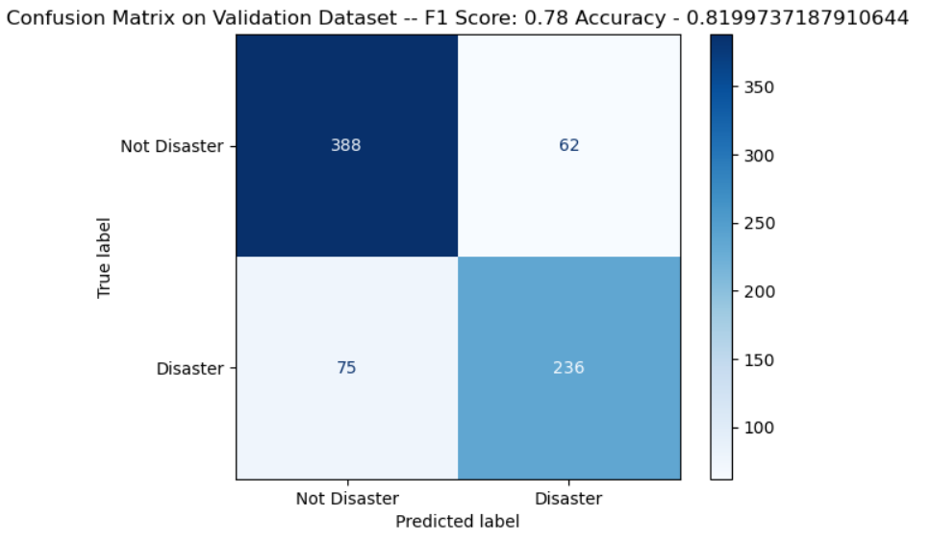
Purdue University | 2025
Results – Ensemble
Validation F1 Score – 0.78
Validation Accuracy – 0.81
Kaggle F1 Score – 0.79

Slide 9
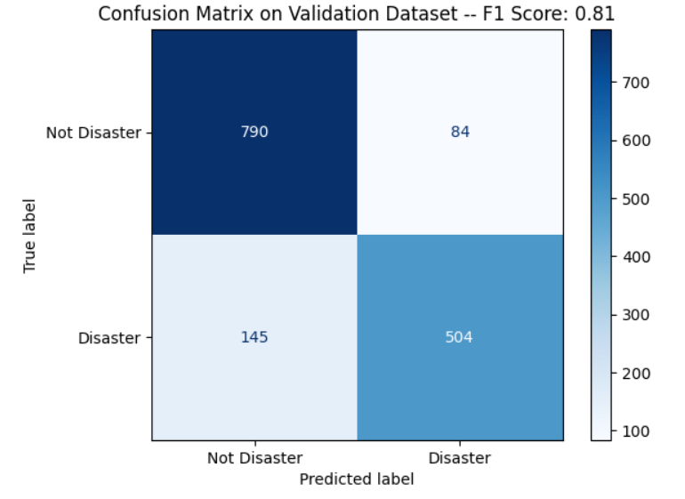
Purdue University | 2025
Results – DistilBERT
Validation F1 Score – 0.81
Validation Accuracy – 0.83
Kaggle F1 Score – 0.83

Slide 10
Purdue University | 2025
Learnings
We found that increasing number of words in the dictionary caused the model to overfit
If the task is a very specific one, adding the embedding layer to the model may be better than using a pre-trained model like Word2Vec as it can learn the embeddings better
Data Augmentation, Ensembling and Layer Normalization helped improve the model performance, if we had re-trained on the full training data and submitted on Kaggle, then the model may have performed a little better
Large Language Models perform much better on this data as compared to LSTMs or GRUs
Data Augmentation + DistilBERT could have possibly given us an even better result, but we did not have the time to implement it

Slide 11
Purdue University | 2025
Thank You!

